Slide 1

A Hyper-Heuristic Approach for Proactive Service Instances Deployment
Presented By
Nura Alam Siddiqe - 182002005
Mahadi Ahammad - 182002006
Safiqul Islam - 182002037
Dept of CSE, Green University of Bangladesh

Slide 2


OVERVIEW
Introduction
Objective
Np-Hard Proof
Multiple Knapsack Problem
Hyper Heuristic
Sine Cosine Algorithm
Jellyfish Search (JS) optimizer
Problem Statement

Slide 3

Introduction
Mobile Edge Computing(MEC)
What is MEC?
Enables cloud computing and edge computing
Why MEC?
Latency for task transmission and computation
It reduce network congestion, signal load of the core network

Slide 4
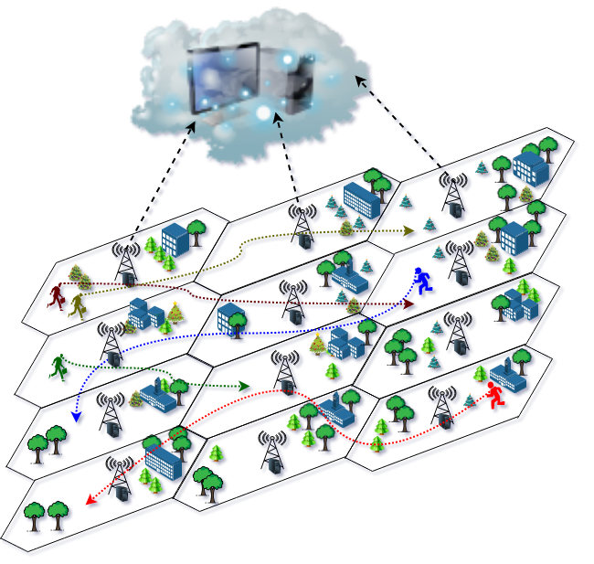
Problem Statement
Proactive Optimal Placement of
Service Instances in a cost efficient way
Fig: mobile-edge computing architecture.

Slide 5
Objectives
Optimally placing the service instances in a proactive manner.
Maximizing Quality Of Experience(QoE)
Create a trade-off between QoE and cost to Keep it within budget.

Slide 6
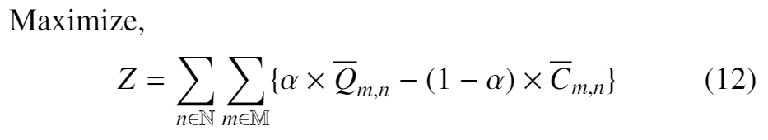
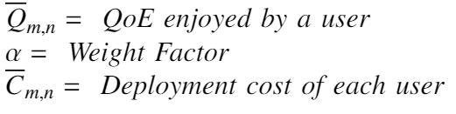
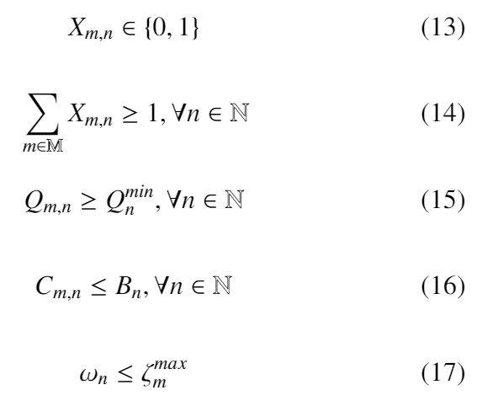
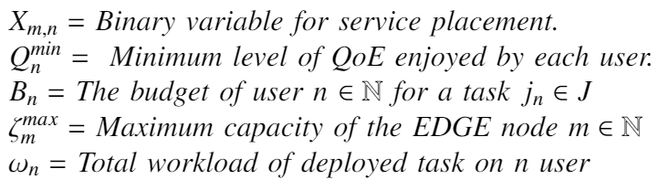
Objectives
Subject to:
C1:
C2:
C3:
C4:
C5:

Slide 7
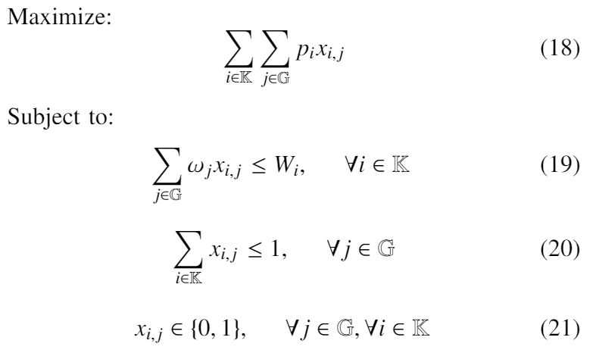
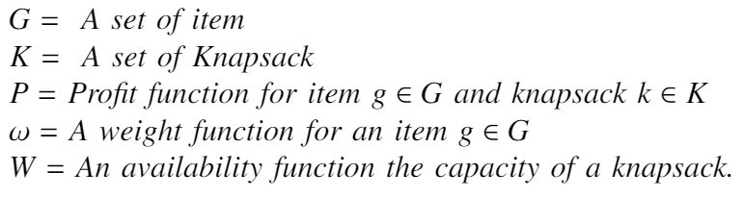
NP-Hard Proof
Multiple Knapsack Problem:

Slide 8
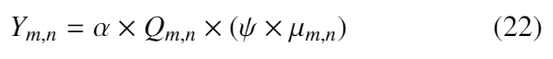
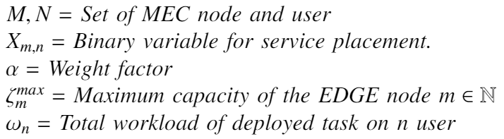
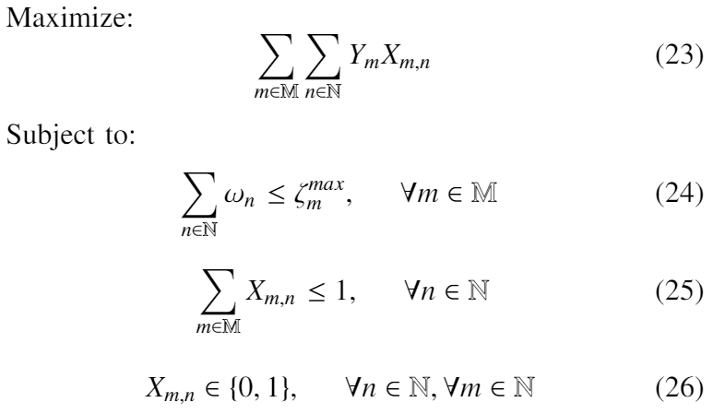
NP-Hard Proof
Assume,
Np-Hardness Proof:

Slide 9
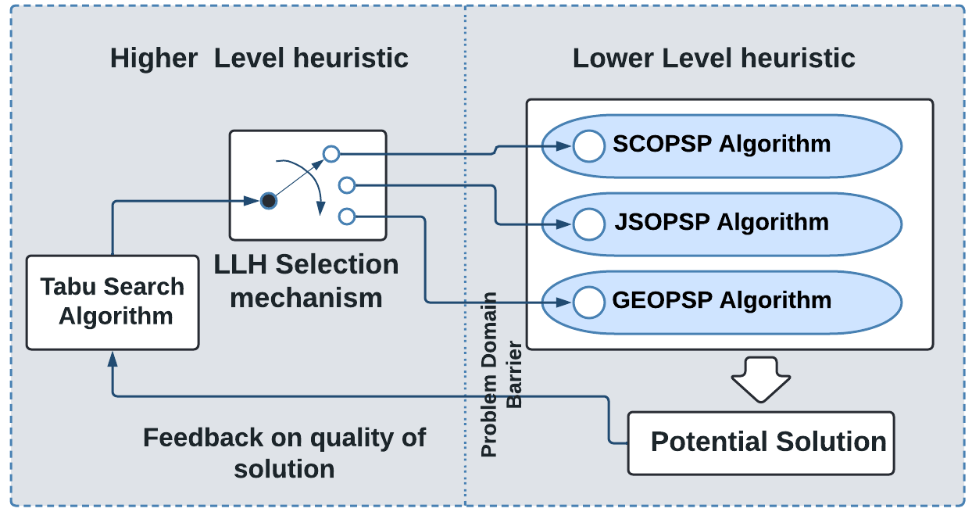
Proposed Hyper-heuristic Strategy For
Proactive Service Placement (HPSP)
Fig: Structure design of HPSP Algorithm

Slide 10
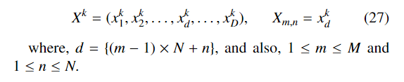
Population Representation
In proactive service Placement (PSP), we assume
A set of candidate solutions G.
The position of a candidate solution k ∈ G which is a D-dimensional binary vector.
Here D = M × N.

Slide 11
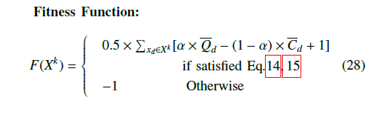
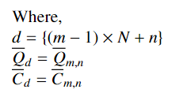
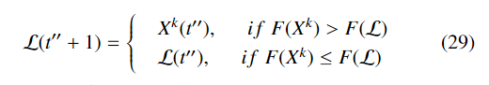
Population Representation

Slide 12
Higher Level Heuristic- HPSP Algorithm

Slide 13
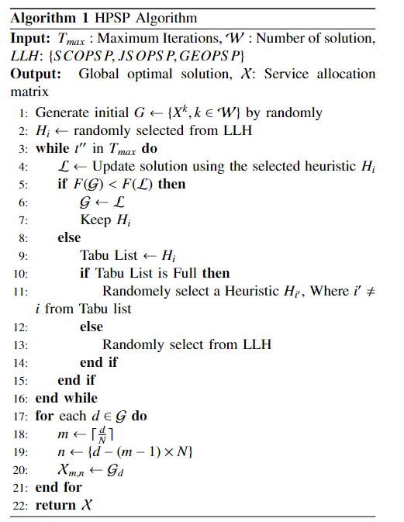
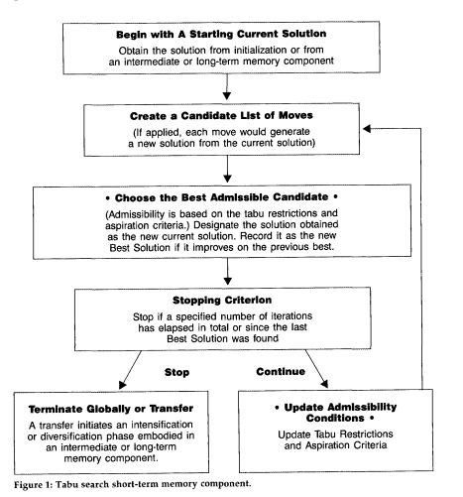
Fig: Flowchart of Tabu search algorithm
Fig: HPSP Algorithm

Slide 14
Jellyfish Search Optimizer For Proactive Service Placement (JSOPSP)
Meta Heuristic II

Slide 15
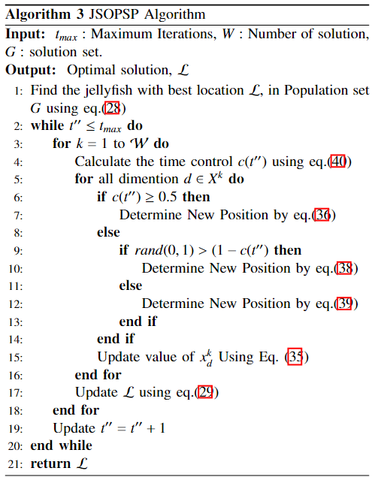
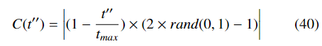
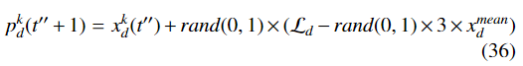
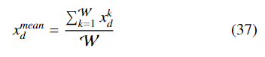
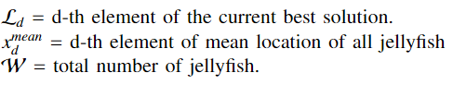
JSOPSP
Time Control Function:
Position Based on Ocean Current:

Slide 16
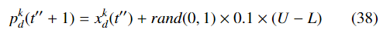
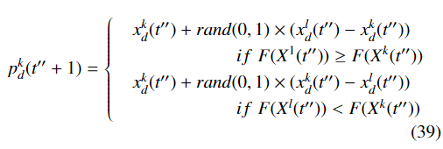
JSOPSP
Position in Swarm:
Type A movement:
Type B movement:

Slide 17
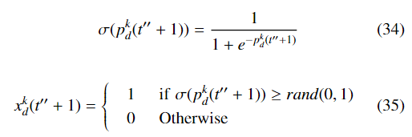
JSOPSP

Slide 18
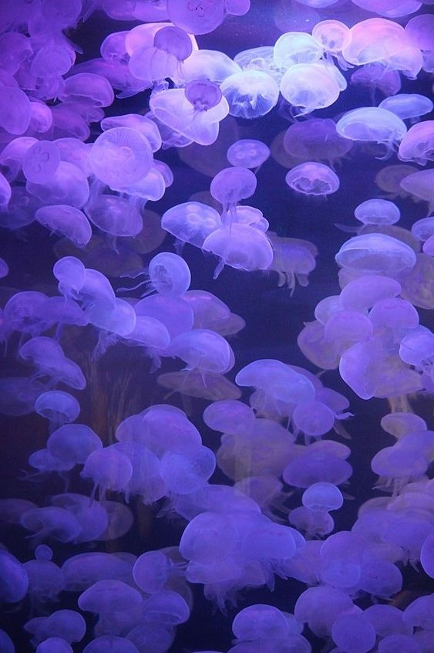
Jellyfish Search (JS) optimizer
Inspired by search behavior and movement of jellyfish in the ocean.
They move in the ocean in search of food.
Jellyfish are weak swimmer and mostly depend on ocean current.
In Swarm, Two type of motion can be observed.
Active Motion
Passive Motion
A “time control mechanism” use to switch between types of movement.

Slide 19
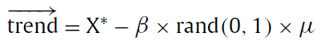
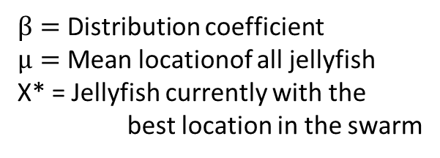
Jellyfish Search (JS) optimizer
Movement with Ocean current
The direction of the ocean current ($\vec{trend}$ ) is determined by averaging all the vectors from each jellyfish in the ocean to jellyfish that is currently in the best location,
………1
$β=$ Distribution coefficient
$µ=$ Mean locationof all jellyfish
X* = Jellyfish currently with the best location in the swarm
………2
….3
[N.B: After sensitivity analysis in numerical experiments $β$=3 was found]

Slide 20
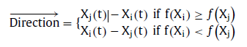
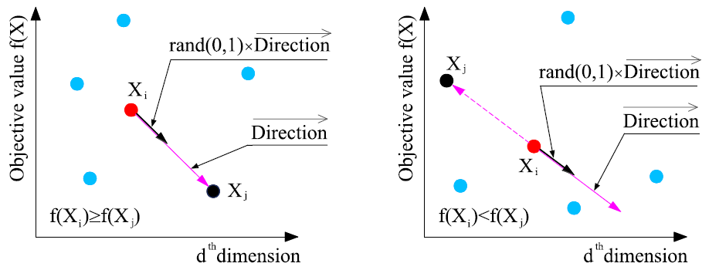
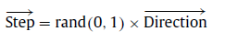
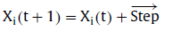
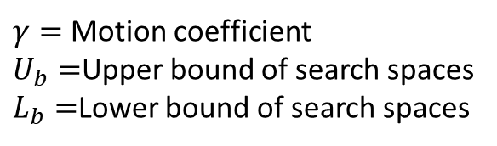
Jellyfish Search (JS) optimizer
Movement in Swarm
Passive motion (Type-A): Around their own locations
$γ=$ Motion coefficient
$U_{b}=$Upper bound of search spaces
$L_{b}=$Lower bound of search spaces
………4
Active motion (Type-B):
………5
………6
………7

Slide 21
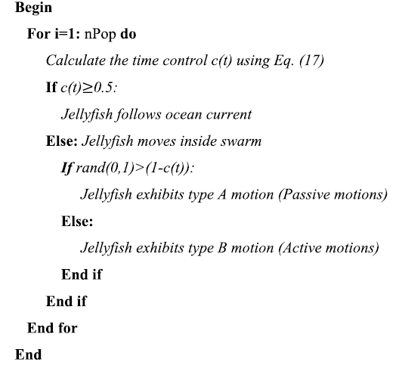
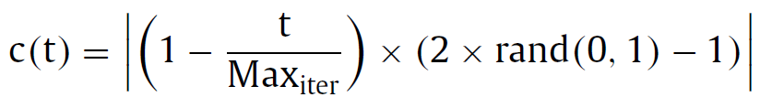
Jellyfish Search (JS) optimizer
Time control mechanism
To regulate the movement between following the ocean current and moving inside the jellyfish swarm.
It includes a time control function c(t) and a constant Co.
8
………8

Slide 22
Jellyfish Search (JS) optimizer

Slide 23
Jellyfish Search (JS) optimizer
Schematic representation of artificial JS optimizer
Exploration
Exploitation
Movement toward the ocean current
Switch
Movements within a jellyfish swarm
Time control mechanism

Slide 24
Sine Cosine Algorithm
Meta Heuristic I

Slide 25
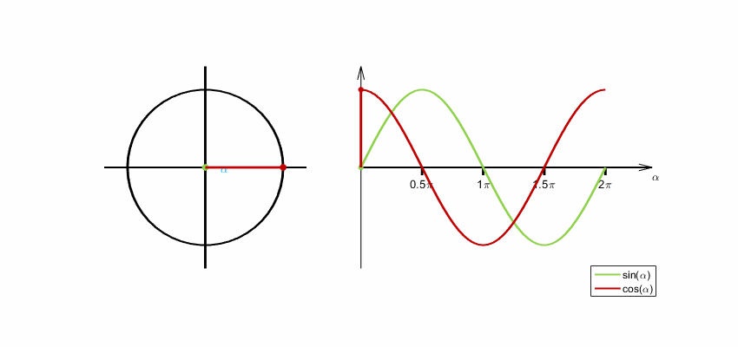
Sine Cosine Algorithm
Two phases
Exploration phase
Exploitation phase
Fig 1 : Mathematical model based Graphs
of the Sine and Cosine Functions

Slide 26
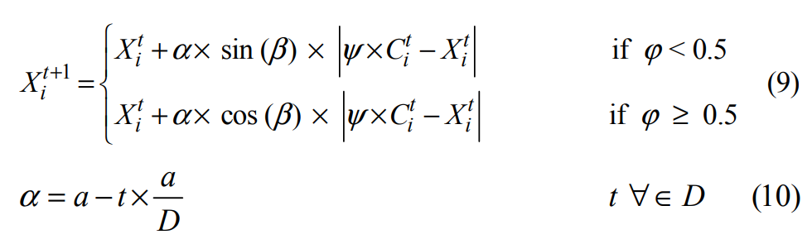
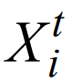
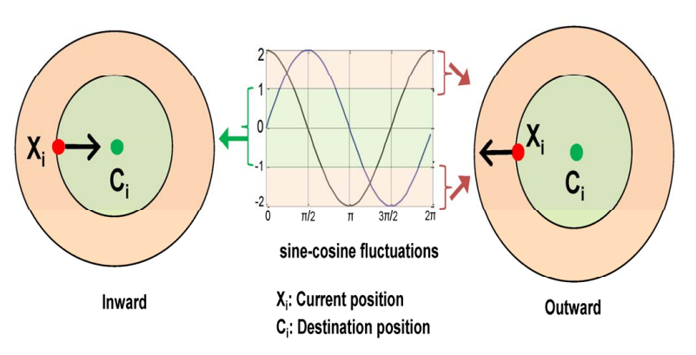
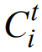
Sine Cosine Algorithm
= Current position of i_{th} population in t_{th} iteration
𝝰 = Sinusoidal nature controlling parameter
𝞫 = Random number in [0, 2π]
Ψ and 𝝋 are random numbers in [0, 1]
= Position of the destination point
a = Sinusoidal nature constant
D = Maximum number of iterations.
Fig 2 : Trajectory path of the population of SCA algorithm

Slide 27
Sine Cosine Algorithm
Initialize a set of search agents (solutions)(X)
Do
Evaluate each of the search agents by the objective function
Update the best solution obtained so far( (P=X *)
Update 𝝰 , 𝞫 , Ψ , and 𝝋
Update the position of search agents using Eq. (9)
While(t< maximum number of iterations)
Return the best solution obtained so far as the global optimum
To balance exploration and exploitation, the range of sine and
cosine in Eqs. (9) is changed adaptively using Eqs. (10)

Slide 28
Sine Cosine Algorithm
Creates and improves a set of random solutions
Smoothly transits from exploration to exploitation
Different regions of the search space are explored
Promising regions of the search space is exploited

Slide 29
Referance
[1] Fan Tang, Chubo Liu, Kenli Li, Zhuo Tang, Keqin Li, “Task migration optimization for guaranteeing delay deadline with mobility consideration in mobile edge computing” in Journal of Systems Architecture 112(8):101849 (2021).
[2] Farris, T. Taleb, M. Bagaa, and H. Flick, ‘’Optimizing service replication for mobile delay-sensitive applications in 5g edge network," in 2017 IEEE International Conference on Communications (ICC), 2017, pp. 1-6.
[3] Yiming Miao, Gaoxiang Wu, Miao Li, Ahmed Ghoneim , Mabrook Al-Rakhami , M. Shamim Hossain “Intelligent task prediction and computation offloading based on mobile-edge cloud computing. ”in Future Generation Computer Systems 102 (2020) 925–931.
[4] Zhihan Lv, Dongliang Chen, Ranran Lou, Qingjun Wang “Intelligent edge fgfgh
based on machine learning for smart city” in Future Generation Computer Systems 115 (2021) 90–99.
[5] Palash Roy, Sujan Sarker, Abdur Razzaque, Mohammad Mehedi Hassan “AI-enabled Mobile Multimedia Service Instance Placement Scheme in Mobile Edge Computing” in Computer Networks Volume 182, 9 December 2020, 107573.
[6] Seyedali Mirjalili “A Sine Cosine Algorithm for Solving Optimization Problems” in Knowledge-Based Systems Volume 96, 15 March 2016.
[7] Jui-Sheng Chou, Dinh-Nhat Truong “A novel metaheuristic optimizer inspired by behavior of jellyfish in ocean” in Applied Mathematics and Computation, 12 July 2020.
[8] Palash Roy, Sujan Sarker, Abdur Razzaque, Mohammad Mehedi Hassan “Hyper-heuristics: A survey of the state of the art” in Journal of the Operational Research Society · July 2013.

Slide 30


